Slide 1
EE-111 Digital Logic Design
Instructor: Dinar Nadir.
M.E Electronics System Engineering M.U.E.T
B.E Electronics M.U.E.T

Slide 2
Reading Material
Digital Logic And Computer Design
By Morris Mano.

Slide 3
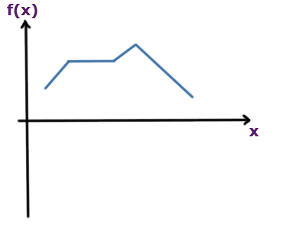
What is Signal?
Signal is a function that represents the variation of a physical quantity with respect to any parameter.
In above fig, f(x) is the signal or function and x is the independent variable.
In electrical and electronics, usually signal is variation of electrical quantity (generally I or V) with time.
If current or voltage remains same with change in time then it is not a signal it is a dc value.

Slide 4
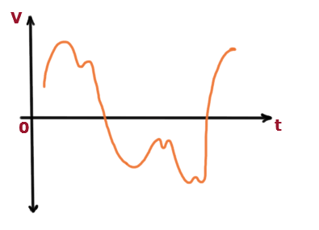
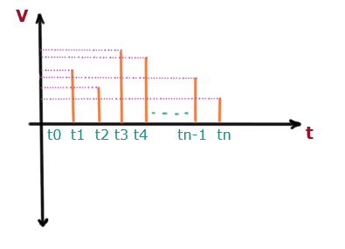
Analog Signal:
Analog signal is a signal which can take any value within the given limit.
Discrete Time Signal:
The signal which is defined for discrete intervals of time is called discrete time signal.
.

Slide 5
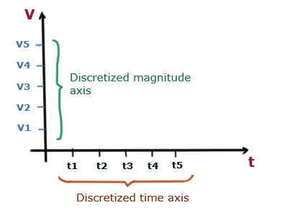
In case of discrete time signals, the x-axis (time axis) is discretized in equal intervals.
Discretization of time axis means division of time axis in equal intervals.
All real life signals are analog in nature.
Digital Signal:
In digital signals, we discretize both time and magnitude. We divide the magnitude axis into fixed number of levels and the signal can take value equal to these levels only.

Slide 6
At any time, if the value is not equal to allowed levels, just take the lower level as the value for that time. example: Lets say allowed levels are 0V, 5V, 10V, and 15V. Value of signal at any time t is equal to 9V. At first sight it looks good to take 10V as the value but we will take 5V.
On increasing number of levels accuracy increases and thus error decreases.

Slide 7
Need Of Digital Signal:
All real life signals are analog in nature and at first sight, it seems use of analog is much better as compared to digital signal. But digital signals have various advantages over the analog signal like noise immunity.
Digital signal is used in communication process to minimize the effect of noise.
Unwanted signals are called noise.

Slide 8
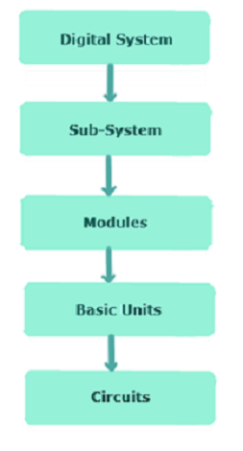
Introduction to Digital Elcetronics.
We use analog to digital converter to convert analog signal to digital signal.
Computer, calculator, digital watch, measuring instruments are some examples of digital system.
We use digital to analog converter to convert
digital signal back to analog signal.

